Slide 1
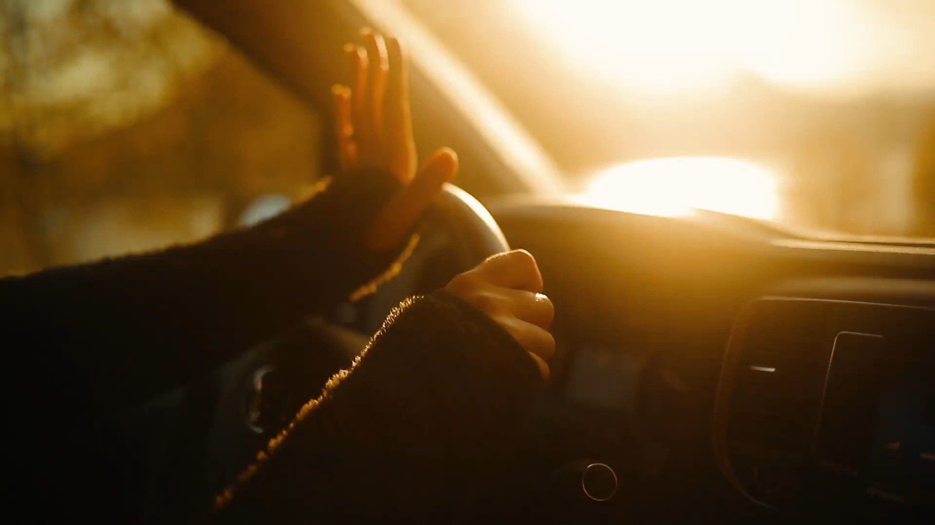

Detecting Driver Distraction Using Deep-Learning Approach
Done By:
Fatimah Alqahtani
Rawabi Almutiri
Raghad Alsaqer
Gadeer Alsneedi
Afrah Alshrari
Dec, 2020

Slide 2
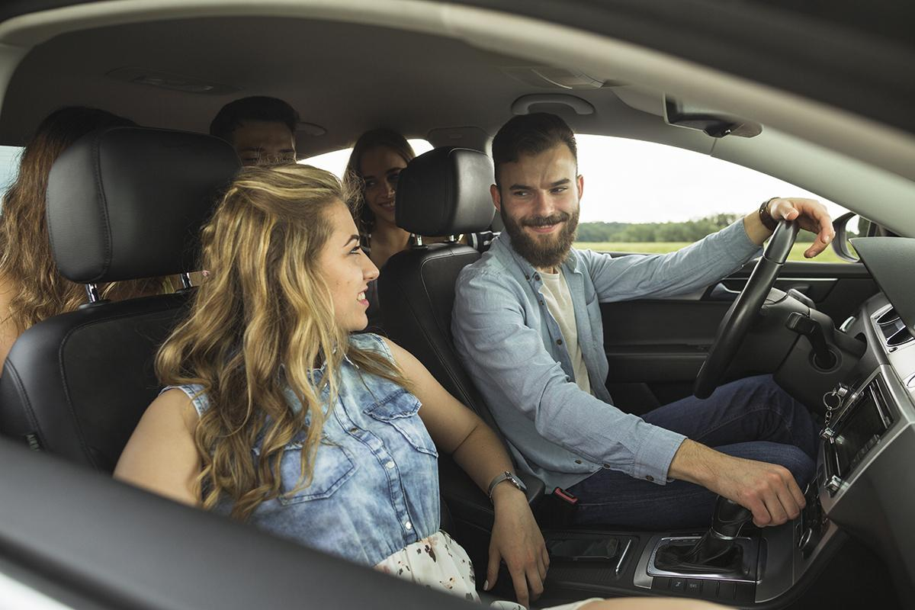
Outlines
01
Introduction
02
Dataset
03
Algorthim and result
04
Future work

Slide 3
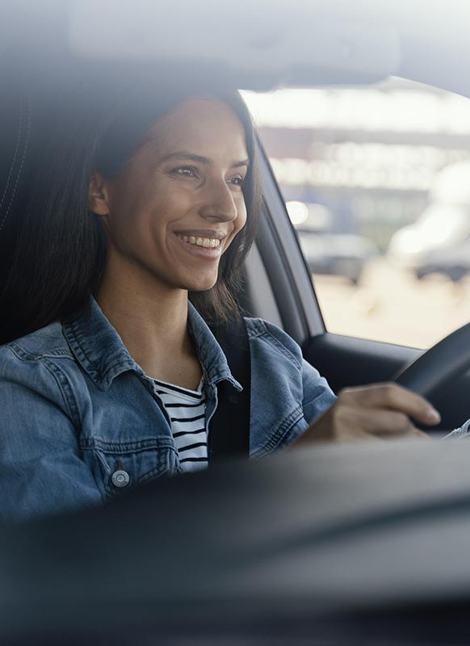
01
Introduction

Slide 4
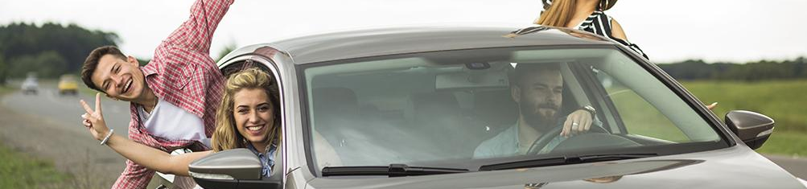
Distracted Driving
Driving while engaged in any activity that could divert a person's attention away from the primary task of driving

Slide 5
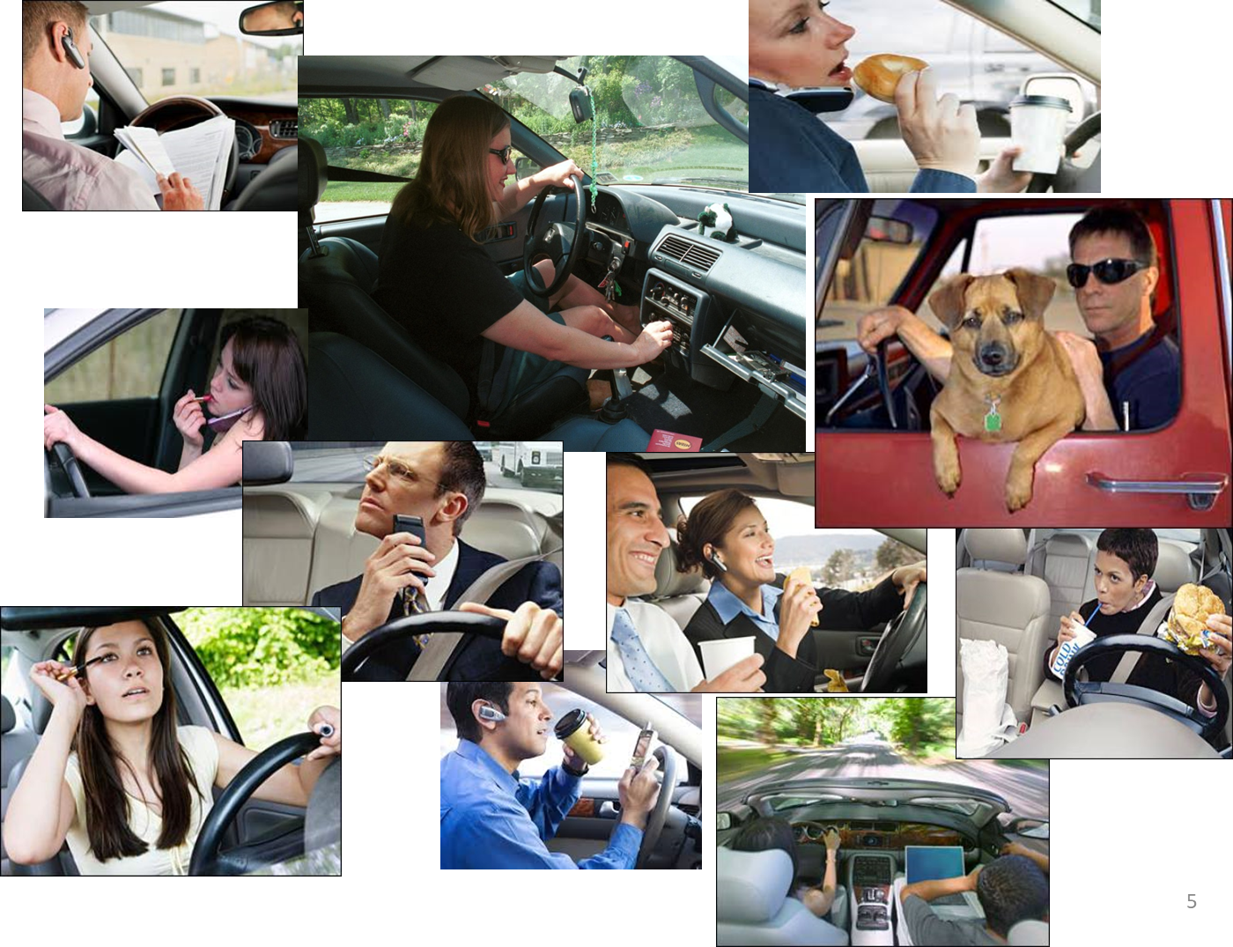

Slide 7
Objectives
What type of things that distract drivers while they drive?
What are the most dangerous distractions that cause accidents?
Designing a mechanism to find the relationship between facial features and idleness that leads to distraction?

Slide 8
Objectives
What type of things that distract drivers while they drive?
What are the most dangerous distractions that cause accidents?
Designing a mechanism to find the relationship between facial features and idleness that leads to distraction?

Slide 9
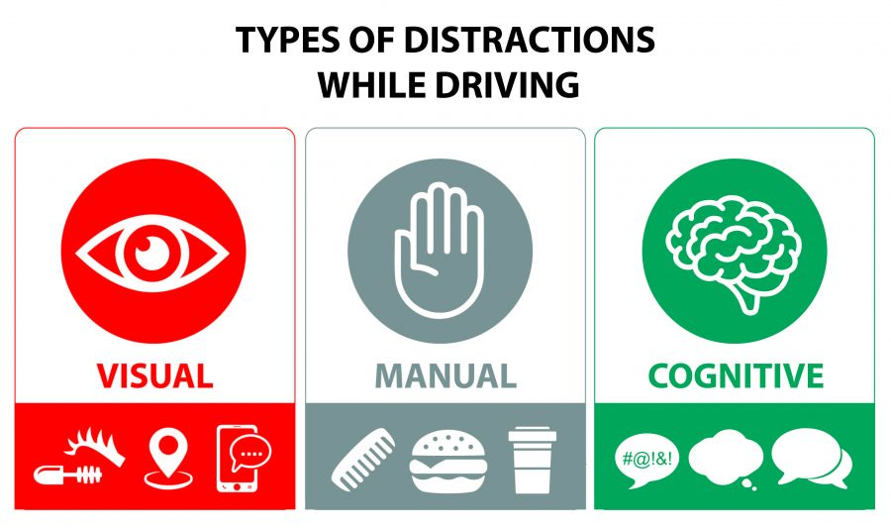

Slide 10
02
Dataset

Slide 11
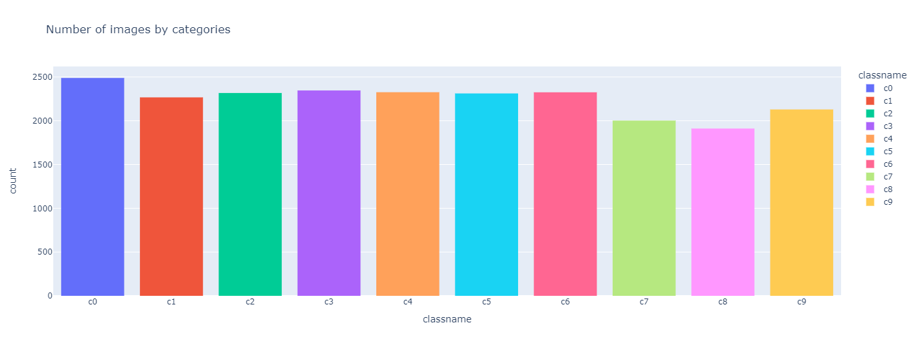
Dataset
Kaggle
102150 images

Slide 12
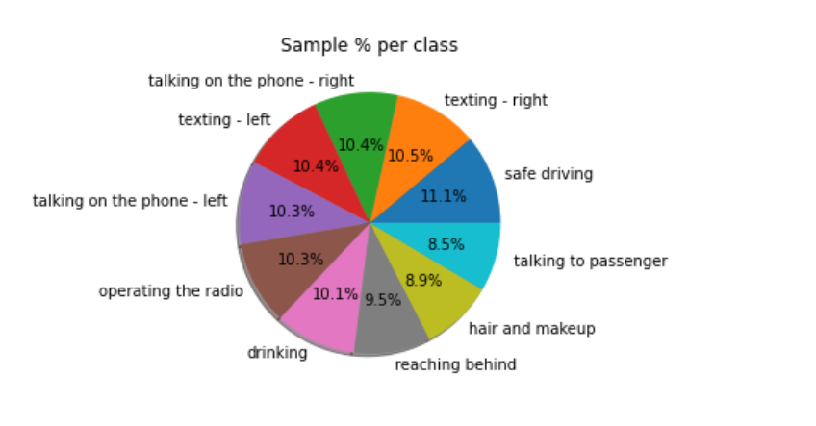
Classes
There 10 classes to classify are :
c0: safe driving
c1: texting - right
c2: talking on the phone - right
c3: texting - left
c4: talking on the phone - left
c5: operating the radio
c6: drinking
c7: reaching behind
c8: hair and makeup
c9: talking to passenger

Slide 13
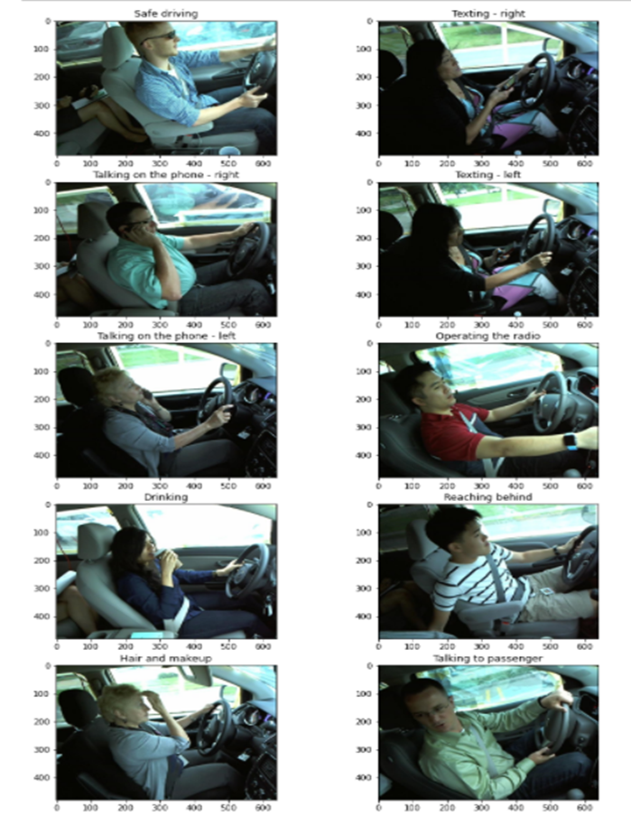

Slide 14
03
Algorithm

Slide 15
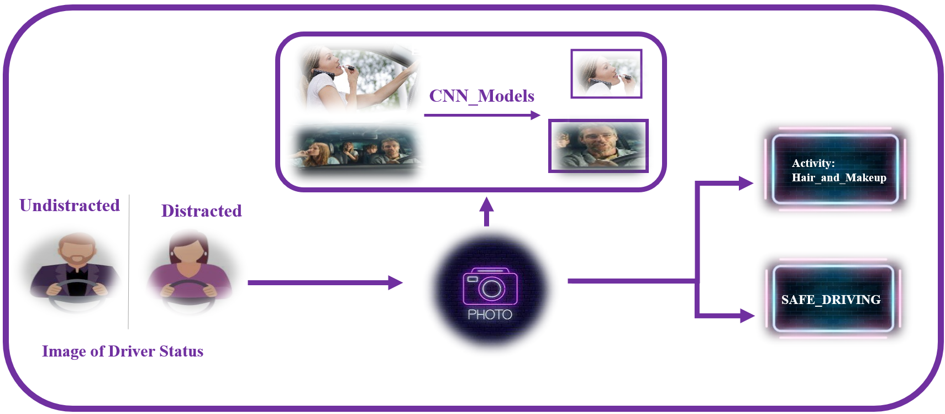
Overview

Slide 16
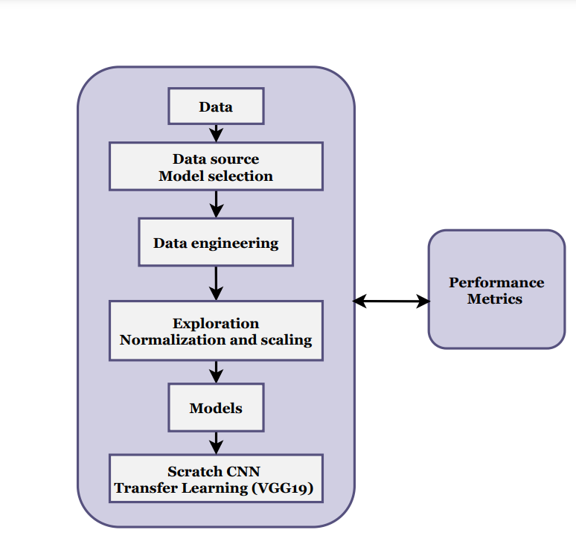
Algorithm

Slide 17
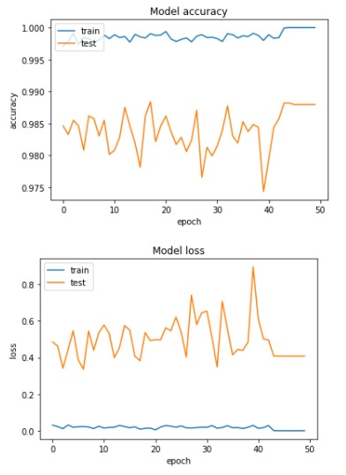
What happen?

Slide 18
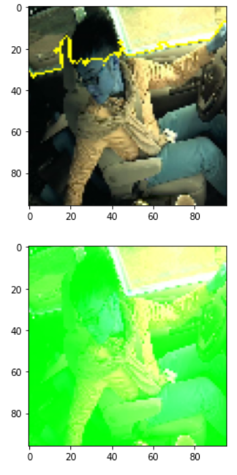
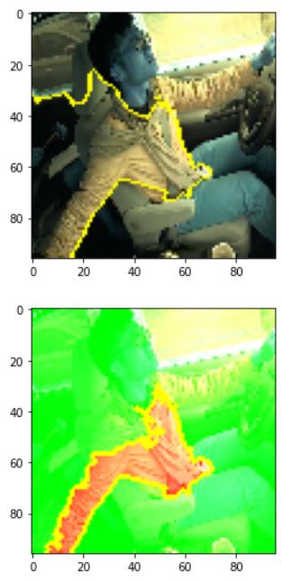
Solution

Slide 19
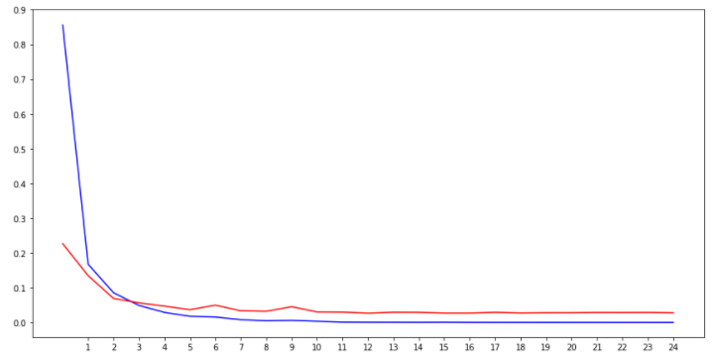
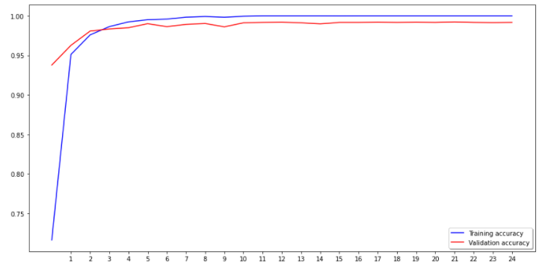
Accuracy
Loss function
Accuracy

Slide 20
Selected model:
Model | Accuracy | Precision | Recall | F1 score
VGG19 | 0.99 | 0.99 | 0.99 | 0.99

Slide 21
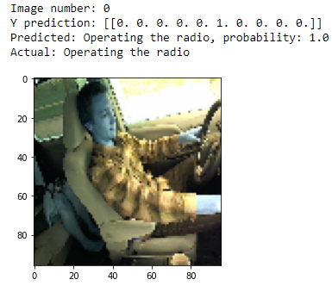
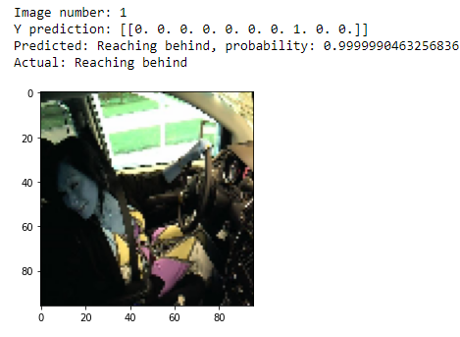
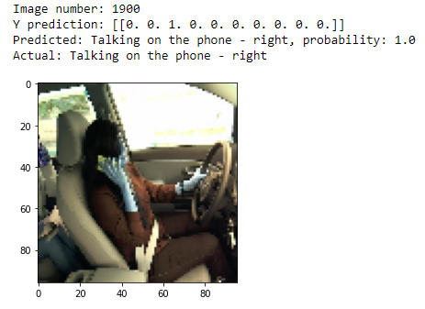
Test model

Slide 22
Future Work
Pictures of the driver will be capture on real time
Use motion sensor
The model should deal with the direction of the car on street

Slide 23
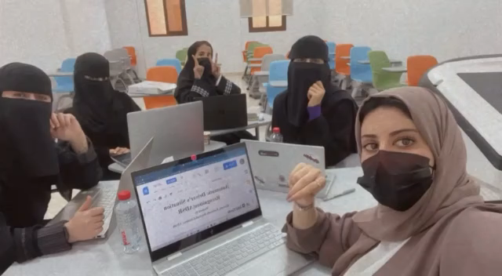
Thank you SDAIA ♥

